Slide 1


AlienBee Power and Mass Budgets
Item | QTY | Mass [g] | Curr [mA] | [mW]
Turnigy Nano-Tech LiPo Battery | 1 | 482.7 | -- | --
Odroid XU4 | 1 | 64.2 | 800 | 4000
3DR Radio | 1 | 26.2 | 100 | 330
Pixhawk | 1 | 40.3 | 175 | 1500
FLIR Lepton LWIR Camera | 1 | 0.55 | 5 | 150
Customer Payload (1lb) | 1 | 453.59 | -- | --
AlienBee Quad (Motor, Structure) | 1 | 43 | -- | --
DJI 9443 Propellor (E300) | 4 | 19 | -- | --
Guidance | 1 | 291 | 540 | 12000
ASUS Xtion Pro Live – RGBD camera | 1 | 115 | 500 | 2500
LIDAR-Lite v2 | 1 | 28.1 | 100 | 550
Windows Lifecam Studio Camera | 1 | 128 | 500 | 2500
TOTAL - Guidance |  | 2380 | 1670 | 17980
TOTAL - RGBD |  | 2360 | 2230 | 11530

Slide 2
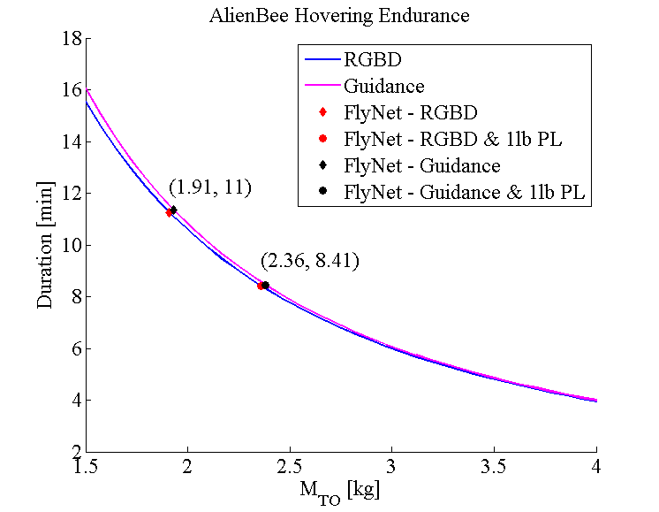
AlienBee Endurance vs. Payload

Slide 3
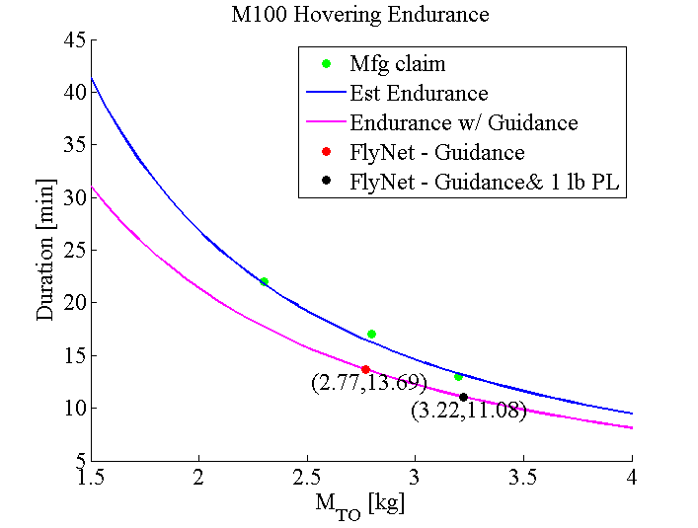
Matrice Endurance vs. Payload

Slide 4
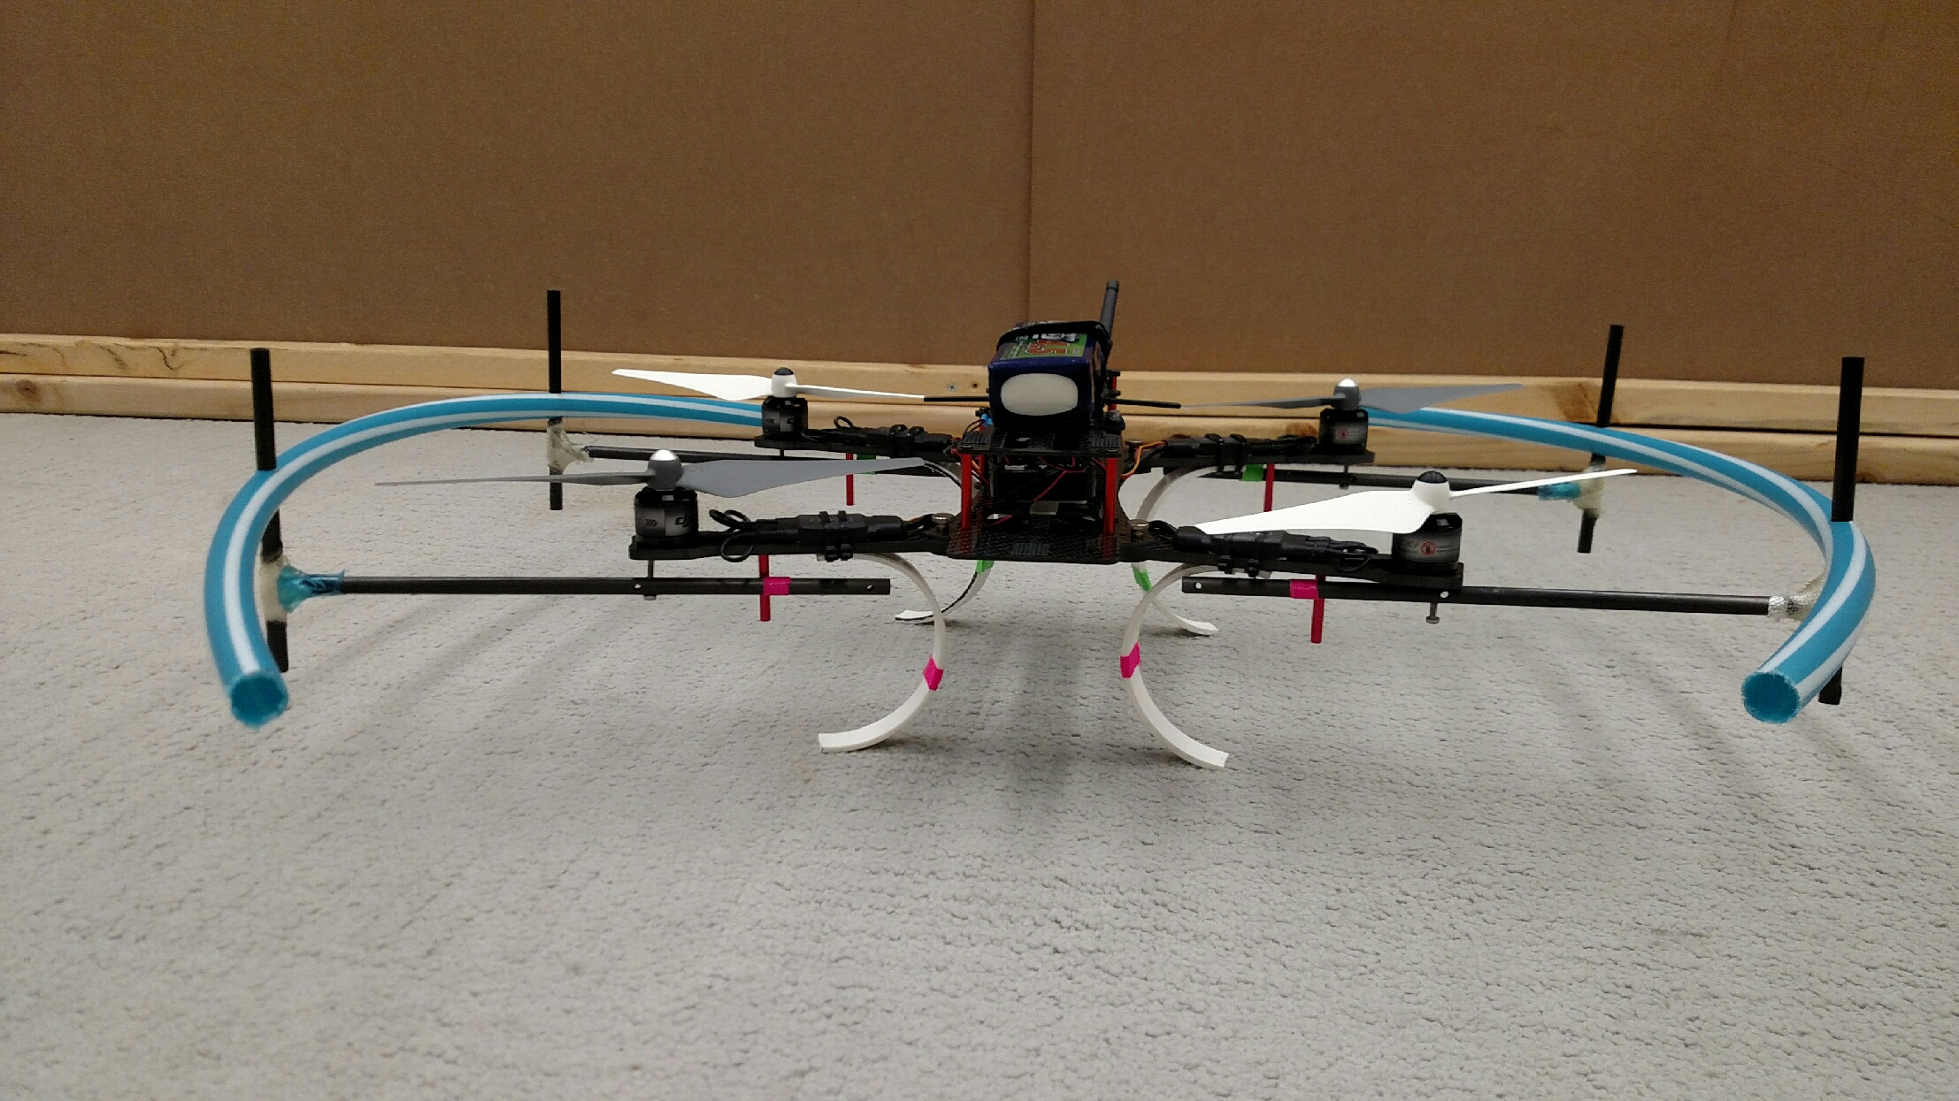
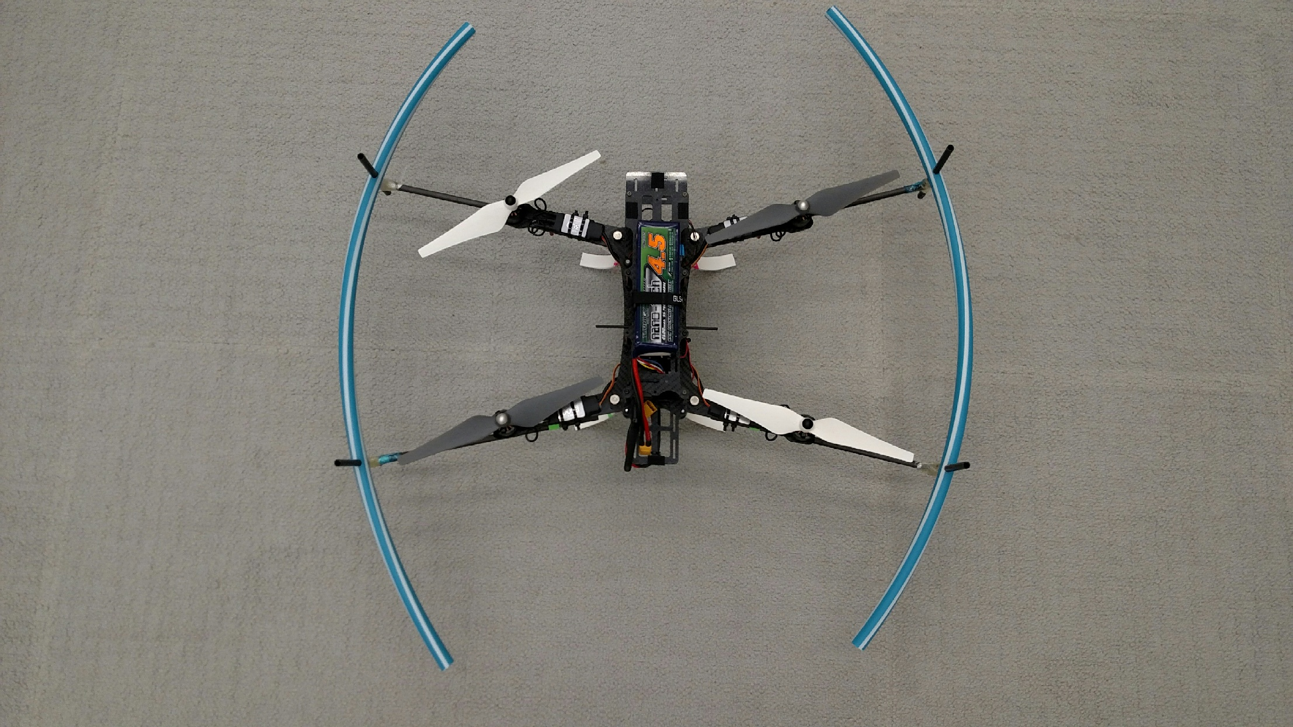
AlienBee Copter with Custom Modifications
Custom blade guards created from a Hula Hoop
Custom Plastic
Landing Gear

Slide 5
FlyNet: Autonomous Quadcopter Search and Rescue
System | Mass Normal (1lb PL) [kg] | Endurance [min] | Endurance w/ 1lb PL [min]
AlienBee w/ RGBD | 1.91 (2.36) | 11.3 | 8.4
AlienBee w/ Guidance | 1.93 (2.38) | 11.4 | 8.5
Time [min] | 8 | 10 | 11
Min Speed [m/s] | 2.31 | 1.85 | 1.67

Slide 6
Matrice 100 Mass Budget
Item | QTY | Mass [g]
Intelligent Flight Battery TB47D | 1 | 600
Odroid XU4 | 1 | 64.2
FLIR Lepton LWIR Camera | 1 | 0.55
Guidance | 1 | 291
DJI Matrice 100 | 1 | 1083
Customer Payload (1lb) | 1 | 453.59
DJI E 620D ESC (E800) | 4 | 43
DJI 1345s Propellor (E800) | 4 | 19
DJI 3510 Motor (E800) | 4 | 106
TOTAL |  | 3220

Slide 7

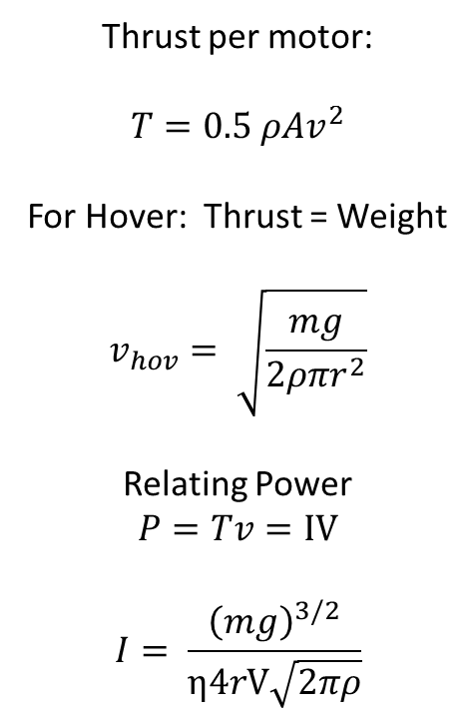
Motor Current Draw
Thrust per motor:
$$T=0.5 ρAv^{2}$$
For Hover: Thrust = Weight
$$v_{hov}= \sqrt{\frac{mg}{2ρπr^{2}}}$$
Relating Power
$$P=Tv=IV$$
$$I= \frac{{\left(mg\right)}^{3/2}}{η4rV\sqrt{2πρ}}$$
r
η
$$v$$
I,V

